Slide 1
Set Up and Installation of Required Softwares
Saurabh Kandhway

Slide 2
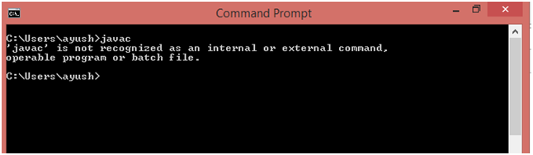
Steps to Install Java
Step 1: Verify that it is already installed or not
Check whether Java is already installed on the system or not. In my case, it is not installed therefore I need to install JDK 1.8 on my computer

Slide 3
Step 2
Step 2: Download JDK
Click the below link to download jdk 1.8 for you windows 64 bit system.
Download JDK For Windows There are available releases for Linux and mac operating systems. You can visit the official link for JDK distributions i.e
JDK Downloads

Slide 4
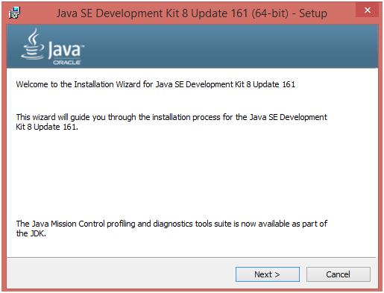
Step 3

Slide 5
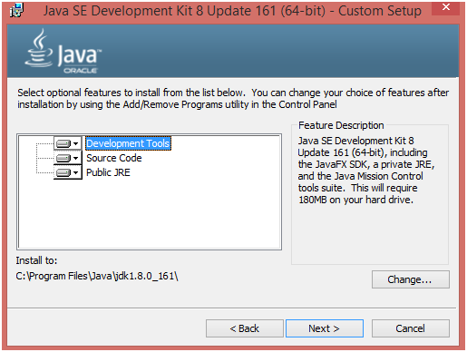
Step 4

Slide 6
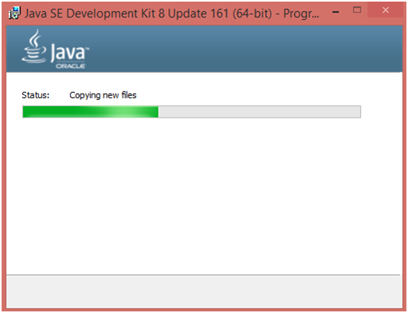
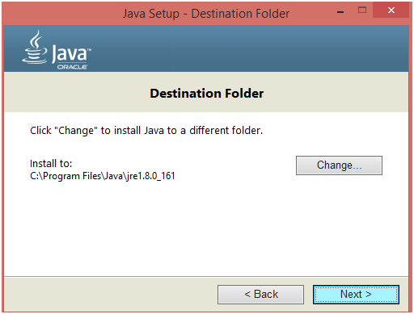
Step 5

Slide 7
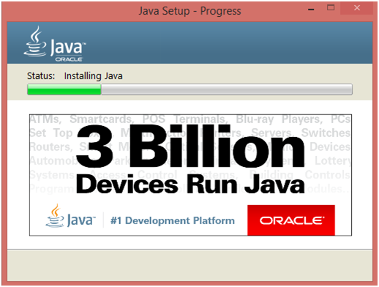
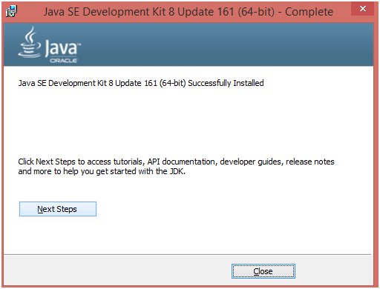
Step 6

Slide 8
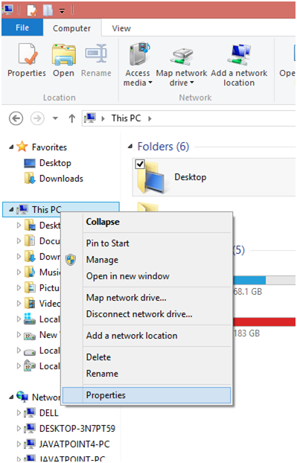
Path Setting for Java
To execute Java applications from command line, we need to set Java Path. To set the path, follow the following steps.
Right click on "this PC". It can be named as "My Computer" in some systems. Choose "properties" from the options.

Slide 9
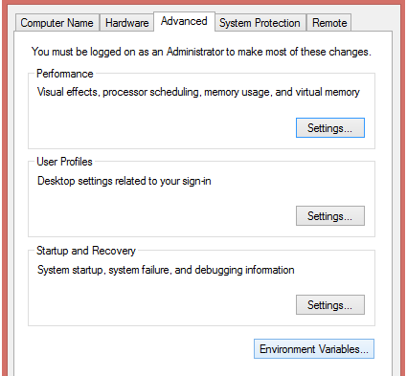
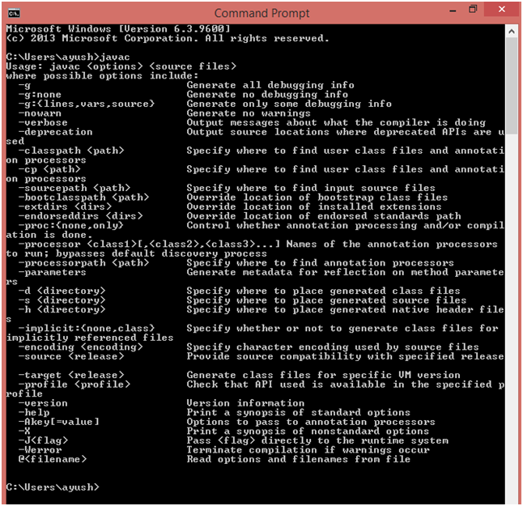
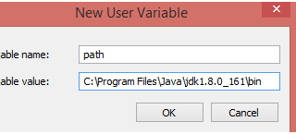
Path Setting in Java
The screen look alike the above image will open. Click on "Advanced system settings" to continue

Slide 10
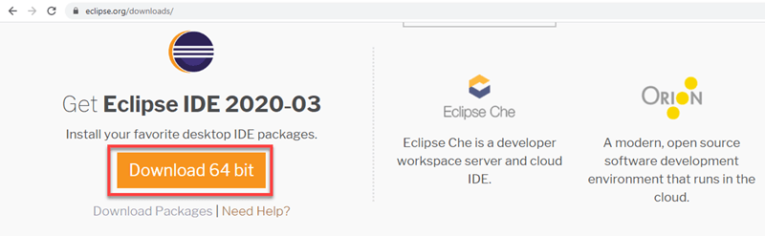
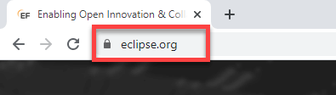
Set Up Eclipse
Step 1
Step 1) Installing Eclipse
Open your browser and type https://www.eclipse.org/

Slide 11
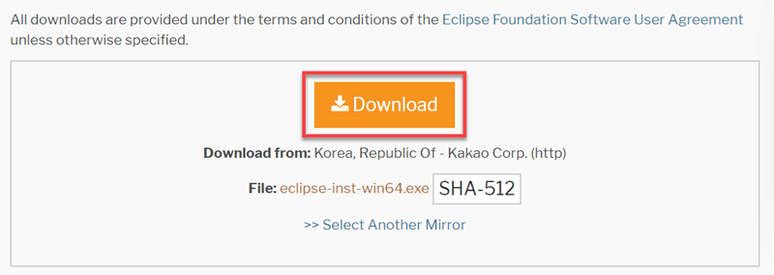
Step 2 for Installing Eclipse
Step 4) Click on “Download” button

Slide 12
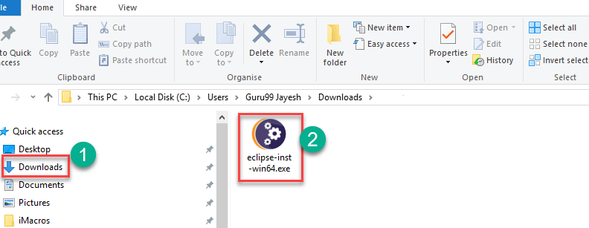
Step 3
Step 4) Install Eclipse.
Click on “downloads” in Windows file explorer.
Click on “eclipse-inst-win64.exe” file.

Slide 13
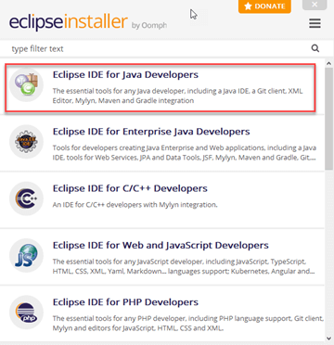
Step 4
Click on “Eclipse IDE for Java Developers”

Slide 14
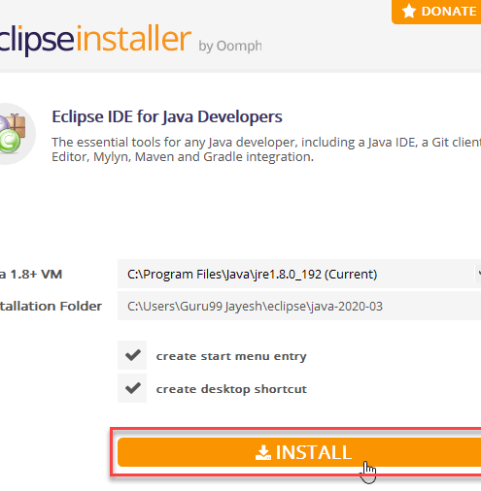
Step 5
Click on “INSTALL” button

Slide 15
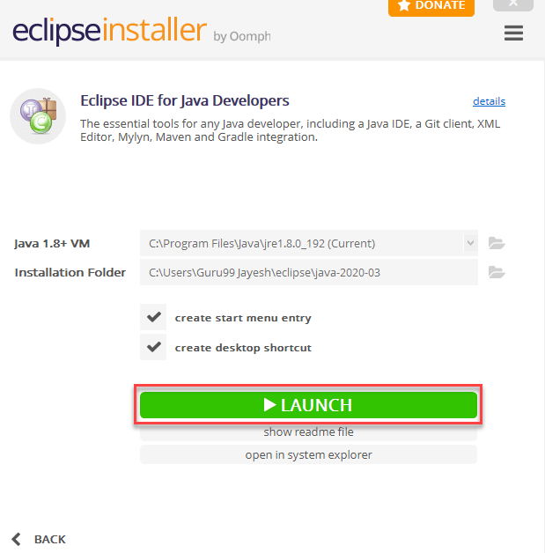
Step 6
Click on Launch button

